Slide 1
Pitch deck
Creation of LLM Model
ACL permission and Query Assistant
Project Presentation
Team Budding Buddies

Slide 2
Project purpose | This project aims to build an offline intelligent assistant using a Large Language Model (LLM) that can understand and respond to both permission-based queries from Excel files and general knowledge questions. The goal is to ensure cost-effective, private, and API-free deployment while offering smart analytics on structured access data.
What it does | Classifies user queries as either general or Excel-based (permission) queries. Uses FAISS for semantic search on Excel row embeddings for permission queries. For general queries, uses a locally hosted Mistral model (GGUF format) for natural language answers.
Solution provided | Local end-to-end QA system powered by Sentence Transformers, FAISS, and Mistral. Handles Excel data with varying permission rules and structures. Simple and intuitive Streamlit interface for user interaction.

Slide 3
Technologies Used | We used Pandas for handling and filtering Excel data, and SentenceTransformers along with FAISS to perform semantic search over permission records. Transformers (FLAN-T5) was used for answering Excel-based queries, while Mistral 7B in GGUF format was used for handling general factual questions. The user interface was built using Streamlit for a simple and interactive experience.
Model Overview | The system uses two different models to handle different types of queries. FLAN-T5 is used for structured, Excel-based permission queries, while Mistral 7B is used for general knowledge and paragraph-style answers. The assistant first classifies the query type and then routes it to the appropriate model.

Slide 4
Sources utilized
Source Type | Details | Purpose in Methodology
Primary Source | Windchill Domain Policy Excel File (permissions.xlsx) | Extracted raw permission data like roles, users, object names, and access rights. This dataset formed the core knowledge base of the assistant.
Primary Source | User Queries (entered via UI) | Captured and analyzed real-time user questions to test the assistant's ability to detect intent, classify query type (general vs permission-based), and return meaningful results.
Secondary Source | PTC Windchill Documentation | Used to understand domain-specific terms like ACL, Download, Modify, Reference Types, and permission inheritance logic. Helped design accurate filtering logic.
Secondary Source | OpenAI Documentation (LLMs) | Used for understanding how to integrate models like FLAN-T5 and Mistral for both factual and domain-specific queries.
Secondary Source | GitHub Issues & Forums (e.g., Hugging Face, llama-cpp) | Helped resolve technical issues like GGUF model loading, FAISS indexing, and deploying large models. These guided environment setup and inference logic.

Slide 5

Team Organization
Manager: Babu Mandem, Aravinda
Associate Manager: Singh, Khushboo
Team: Budding Buddies
Tamilselvan, Yazhini
Aathikkattuvalasu Thirunavukkarasu, Samyugtha

Slide 6
Model Workflow
Retrieve Context
Permission query
FAISS Search
LLM (FLAN-T5)
User Query
Query Classifier
Answer
General query
General LLM (e.g., Mistral)

Slide 7
Challenges Faced
Development Challenges
General vs. Excel query detection was hard; FLAN-T5 failed, so Mistral-7B was used instead.
.gguf models didn't work with Transformers, so llama-cpp-python was integrated.
C++ build errors occurred and were fixed by installing Microsoft Build Tools.
Permission dependencies like "Modify → Read" needed custom logic to validate.
Filtering Excel fields failed due to casing; regex and lowercase matching solved it.
Model responses were messy, so Streamlit and CSS were used for clean output.
FLAN-T5 struggled with facts, so general queries were routed to Mistral.

Slide 8
Deployment Challenges
App crashed due to memory limits; fixed by using CPU Basic on Hugging Face.
Local .gguf model failed to load; solved by uploading to Hugging Face Model Hub.
Absolute file paths broke deployment; switched to relative paths using os.path.join.

Slide 9
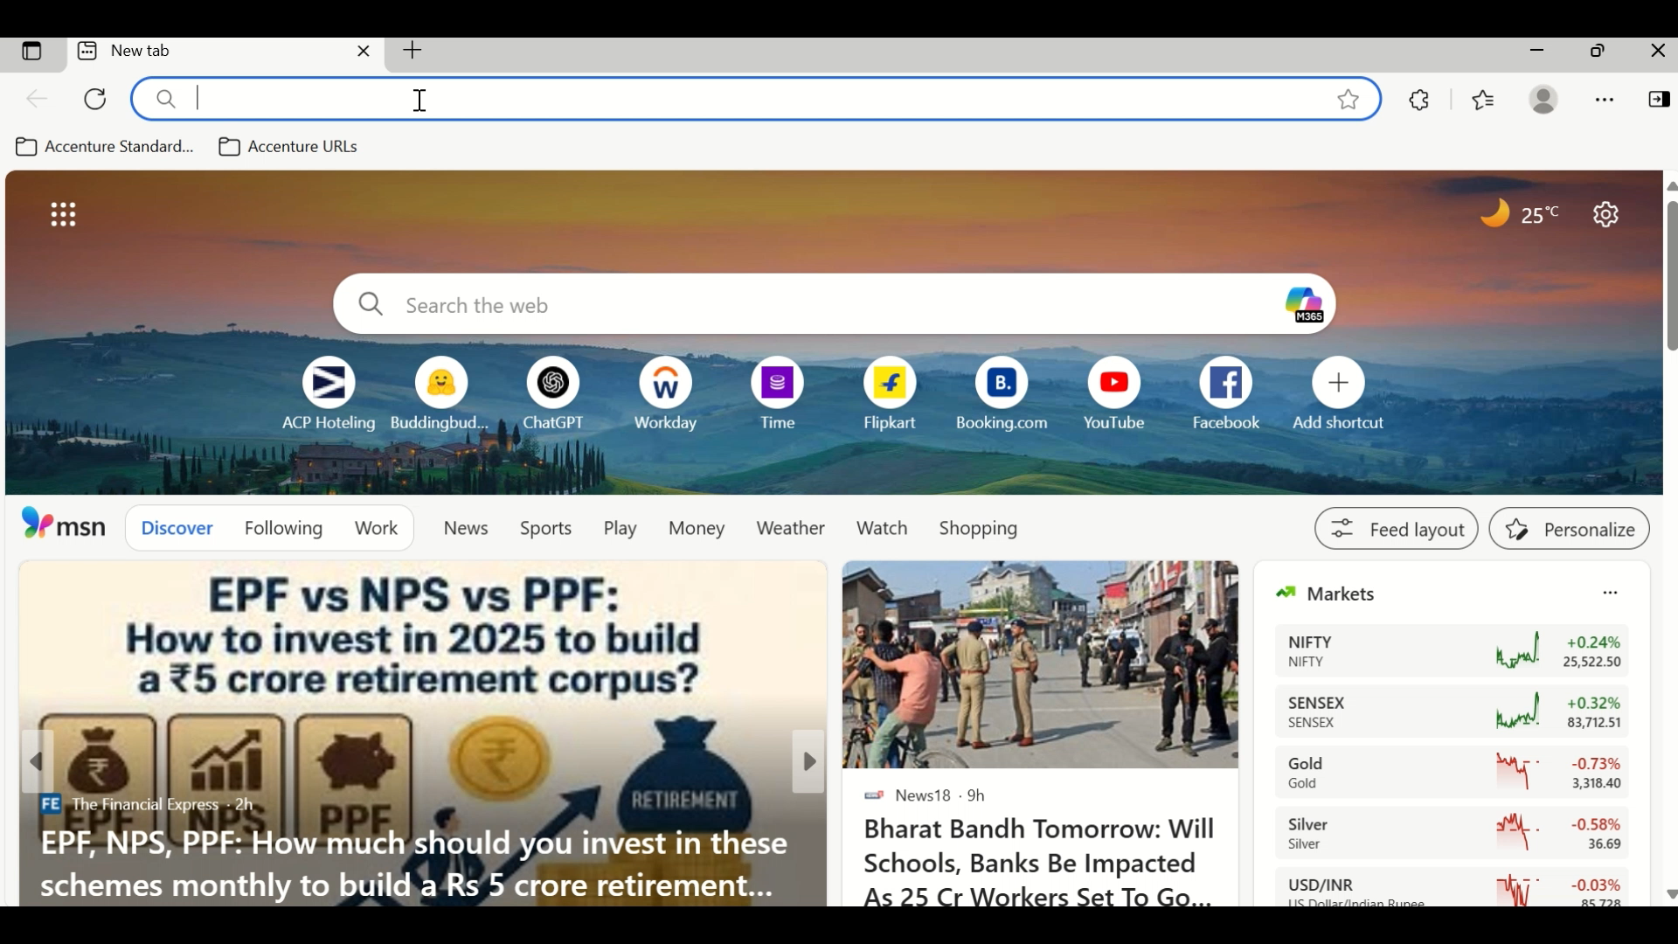
Demo video
This demo showcases a local Permission Assistant that answers both permission-related and general queries using natural language. It checks permission dependencies, filters Excel data, and uses a local model for accurate, contextual responses.

Slide 10
Deployment flow
Develop App
Choose deployment Platform
Connect GitHub Repo to Deploy Platform
Deploy & Test
Prepare Requirement
Upload Code to GitHub
Set Build & Start Command
App Live Online

Slide 11
Key Learnings & Takeaways
Topic | Takeaway
Virtual Terminal Usage | Learned to run, debug, and manage Python apps using terminal commands and virtual environments.
Version Compatibility | Resolved errors by downgrading/upgrading libraries (e.g., llama-cpp-python, transformers) for model and FAISS compatibility.
Python Package Exploration | Gained experience with advanced libraries like: • sentence-transformers (Text embedding ) • faiss – Fast similarity search • llama-cpp-python – Local LLM inference • transformers – Pretrained model use • streamlit – Web UI development
Excel Data Handling | Learned to extract, filter, and analyze permission data using pandas, including handling reference types and unique counts.
Deployment Skills | Successfully deployed the app on Hugging Face Spaces, learning project structuring, caching models, and resolving memory/runtime issues.

Slide 12
Future improvements
In the next phase, we aim to enhance the accuracy of general question answering by fine-tuning or replacing the current LLMs with models better suited for factual reasoning.
Voice query support is also planned to make the assistant more accessible and user-friendly. To further improve domain accuracy, we intend to fine-tune a custom LLM on permission-related datasets.
If required in the future, we may integrate a fallback to Google Search to handle out-of-scope queries.
Finally, the user interface will be enhanced with better styling, dark mode compatibility, and dynamic response formatting for improved usability.

Slide 13
Thank you

